Slide 1

ATM TRANSACTIONS REPORT
Wisabi Bank

Slide 2
Introduction
Wisabi Bank is a leading financial institution in Nigeria, headquartered in Lagos with branches in Kano, Rivers State, Enugu, and FCT Abuja. Wisabi Bank provides a wide range of financial services to its customers, including savings accounts, current accounts, loans, and investments. As part of its commitment to improving customer experience and optimizing its operations, Wisabi Bank has engaged you as an external consultant to conduct a data analytics project to analyse its ATM transactions data.

Slide 3
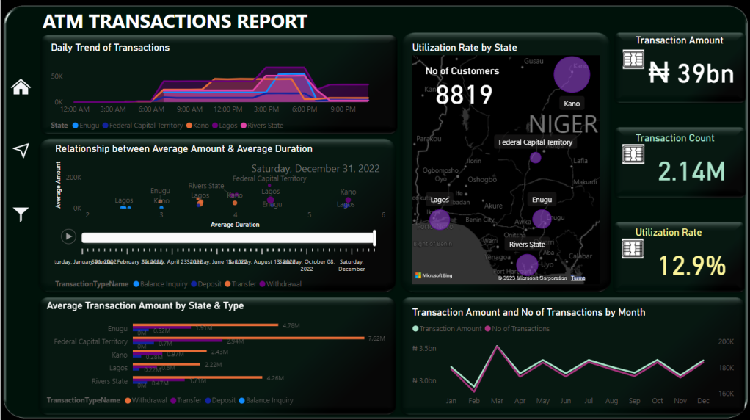

Slide 4
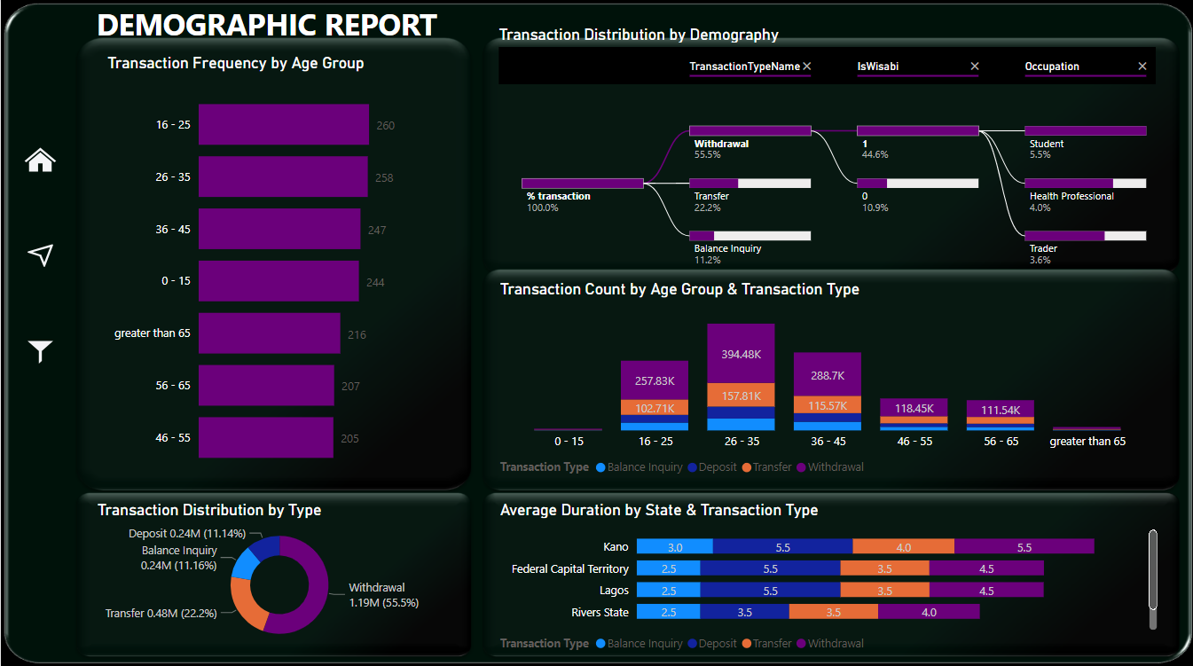

Slide 5
₦38,555,885,000
Total Transactions amount by Wisabi ATMs in 2022
2,143,838
Number of Transaction Processed
8819
Number of Wisabi Bank’s Customeres
12,9%
Utilization Rate

Slide 6
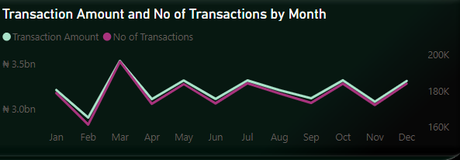
Trend of Transaction Volume and Amount
March has the highest transation amount and number of transaction.
Ferbuary has the lowest.

Slide 7
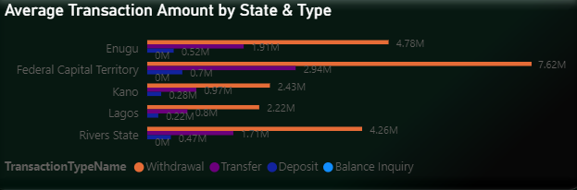
Average Transaction Amount
Withdrawals have the highest transaction amounts across all location, next is Transfer, Deposit and Balance Inquiry.
FCT has a highest Deposit Amount and Lagos has a lowest Deposit Amount on Average.

Slide 8
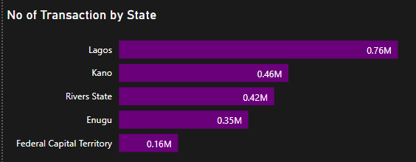
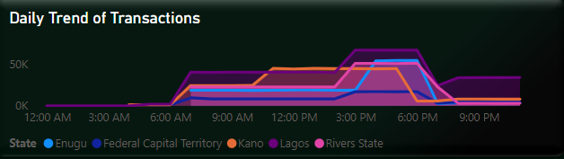
Transactions Trend
Lagos has a highest number of transactions. ATM Transactions in Lagos increase from 6 am and peak between 3 and 7 pm.
Other locations have the same behavior but transactions peak earlier in Kano (around 10 am).
After 7 pm, Lagos has significant transactions activity compared with other states.

Slide 9
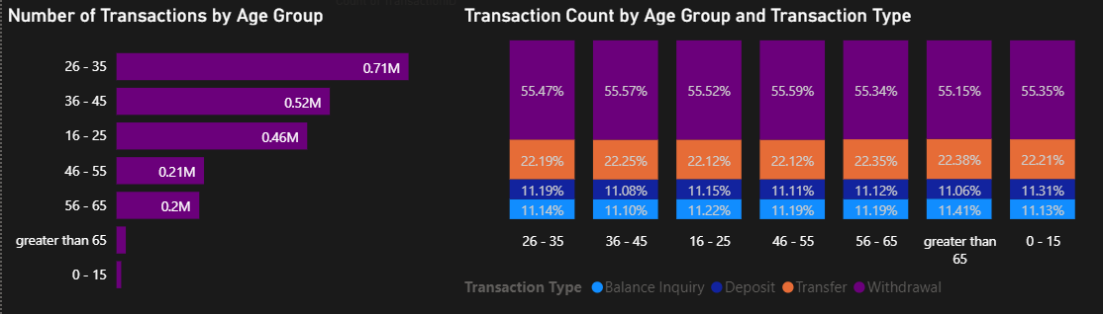
Transactions by Age Group and Type
Customers between 26-35 years have the highest number of transactions (0,71M).
Across all the Age Groups, Withdrawal is a common transaction type (>50%).

Slide 10
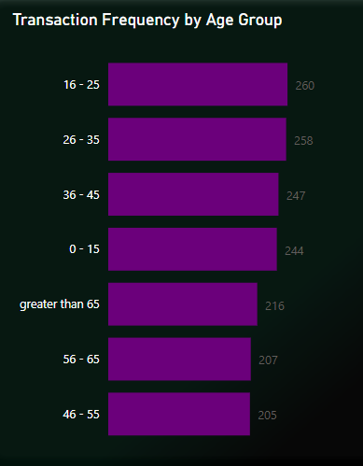
Transaction Frequency by Age Group
There is not much difference in Transaction Frequency between Age Groups.
Customers between 16-35 years have the highest transaction frequency.

Slide 11
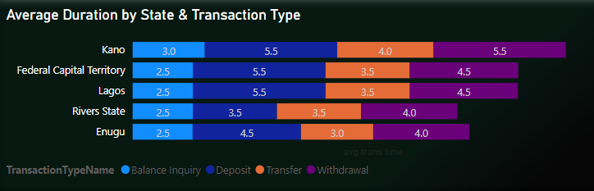
Transaction Duration
Kano’s average Transaction durations are comparatively higher than other locations.
Rivers and Enugu have lower average transaction durations when compared to other locations.
Across all locations, Withdrawals has the longest duration on average.

Slide 12
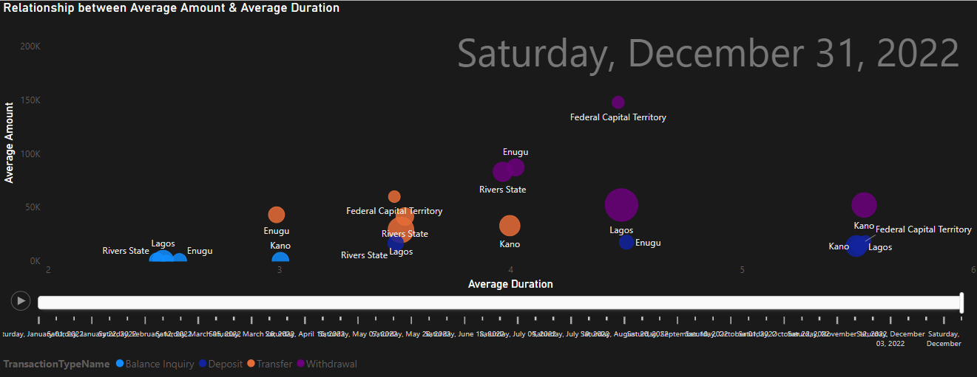
Average Amount vs Average Duration
While transaction amount is comparatively similar, Withdrawals in Kano have the longest transaction duration (>5 mins) when compared with other states.
Kano, Lagos, and the FCT have longer transaction duration for Deposits (>5 mins) while Rivers has the lowest transaction duration for deposits(<4 mins).

Slide 13
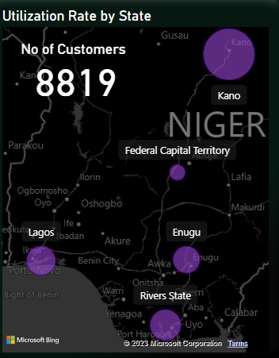
Utilization Rate
ATMs in Kano have the highest Utilization Rate (18,6%).
The FCT has the lowest Utilization Rate (8,5%)

